Slide 1
“Where ideas are transformed into profitable businesses”

Slide 2
INTRODUCTION
What is Pitching?
Presenting an idea, product, or service to an audience (investors, partners, customers).
Objective: Convince the audience to take specific action (e.g., invest, partner, buy).
Why Pitching Matters?
Builds connections. KNOW YOUR AUDIENCE!!!
Opens opportunities for funding and growth.
Demonstrates your value and vision.
Key Elements of a Great Pitch
Storytelling: Create an emotional connection.
Clarity: Be concise and direct.
Problem-Solving: Show how you address a clear need.
Persuasion: Inspire trust and confidence.

Slide 3
ELEVATOR PITCHES
What is an Elevator Pitch?
A 30-60 second pitch that conveys the essence of your idea.
Example: Imagine you meet a top investor in an elevator. You have one minute to convince them.
Structure of an Elevator Pitch
Hook: Start with an intriguing question or fact.
Value Proposition: Clearly state your solution.
Ask: End with a specific request (e.g., schedule a meeting).
Example:
Did you know 75% of small businesses fail due to poor cash flow management? Our app, CashFlowPro, provides real-time financial tracking to help businesses thrive. Can we schedule a meeting to discuss how it can help your portfolio companies?”
Notes:
Scenario 1: EcoBrew: A startup producing biodegradable coffee pods. Pitch to a busy investor in an elevator. Scenario 2: CareCycle: A company repurposing old bicycles into affordable transport solutions. Pitch to a philanthropist.

Slide 4
INVESTOR PITCHES
What is an Investor Pitch?
Aimed at securing funding, with lengths ranging from 90 seconds to 10 minutes.
Short pitches (90 seconds): Focus on the essentials, a "teaser" pitch to spark interest.
Longer pitches (5-10 minutes): Provide more detailed data and analysis for due diligence.
Key Sections of an Investor Pitch
Introduction: Who you are and why this idea matters.
Problem Statement: The pain point you're addressing.
Solution: Your product/service and how it solves the problem.
Market Opportunity: Market size and growth potential.
Business Model: Revenue streams and scalability.
Financials: Key metrics (profit margins, projections).
Ask: Funding required and how it will be used.
Example:
“Our company, SolarGro, provides solar-powered irrigation systems for small-scale farmers. With over 100 million underserved farmers in Africa, the market opportunity is $5 billion. We’re seeking $2 million to scale operations across three new regions, projected to increase revenues by 300% in the next 2 years.”
Notes:
INCASE WE NEED TO SPEAK ABOUT PITCH DECKS: ► Draft a deck outline
► Identify one takeaway per slide
► Create talking points for each slide
► Weave in a story
► Sketch visuals and layout each slide
► Identify data points and sources
► Create first, rough draft in Keynote, etc.
► Design - add visual identity and polish
► Get feedback, iterate
► Rinse and repeat until happy ► Title & contact info
► Exec summary
► Team
► Company purpose
► Problem
► Solution
► Traction
► Market opportunity
► Why now ► Competition
► Competitive advantage
► Business model
► Customer acquisition
► Funding & use of proceeds
► Next 12-18 months

Slide 5
INVESTOR PITCHES
Structure of a 90-Second Investor Pitch
Start Strong (10-15 seconds): Grab attention with a hook (a shocking statistic, a compelling story, or your "why").
Example: "Did you know 40% of small-scale farmers lose their crops due to unpredictable irrigation? We're here to change that."
Problem and Solution (30 seconds): Clearly state the problem and introduce your solution.
Example: "Farmify provides affordable, solar-powered irrigation systems tailored for small-scale farmers. With our solution, crop yields increase by 50%."
Market and Traction (20 seconds): Briefly highlight market potential and what you’ve achieved so far.
Example: "The market for small-scale farming solutions is $1 billion in Africa alone. We’ve already sold 1,000 units in Botswana, generating $200,000 in revenue this year."
The Ask (10-15 seconds): End with a specific funding request and its purpose.
Example: "We’re seeking $500,000 to expand to Zambia and Kenya, enabling us to scale and improve food security for over 10,000 farmers."
Notes:
Scenario 3: Farmify: A platform connecting small-scale farmers to urban markets. Pitch for seed funding. Scenario 4: GameWell: A wellness app gamifying mental health practices. Pitch for Series A investment. Scenario 5: TechBloom: A solar-powered phone charger targeting rural communities. Pitch to a green energy VC. Scenario 6: EduCraft: A virtual reality tool for teaching STEM in high schools. Pitch to an educational foundation.

Slide 6
CORPORATE PITCHES
What is a Corporate Pitch?
Pitching to companies for partnerships or sponsorships.
Focus: Aligning with corporate goals.
How to Craft a Corporate Pitch
Research the Company: Understand their CSR priorities or business goals.
Align Values: Show how your idea benefits them.
Offer Mutual Value: Highlight ROI or impact.
Example:
“CleanWaterCo provides affordable water purification devices to underserved communities. Partnering with your company aligns with your CSR goal of providing access to clean water. Together, we can impact 100,000 families while increasing brand awareness.”
Notes:
Scenario 7: CleanWaterCo: A social enterprise providing water purification devices in low-income areas. Pitch to a beverage company for a CSR partnership. Scenario 8: UrbanFarmX: A vertical farming startup seeking a distribution deal with a supermarket chain. Scenario 9: CycleSense: A fitness startup producing AI-connected exercise bikes. Pitch to a global sports brand.

Slide 7
MEDIA & PUBLIC PITCHES
What is a Media/Public Pitch?
Speaking to the public or media to raise awareness about your idea or brand.
Crafting a Media Pitch
Storytelling: Make it relatable to the audience.
Simple Language: Avoid jargon.
Call-to-Action: Encourage audience participation (e.g., support, follow).
Example:
“Did you know 1 in 3 children lacks access to quality STEM education? Our VR tool, EduCraft, turns learning into an immersive adventure, closing the gap for underserved communities. Join us in shaping the future by supporting EduCraft today!”
Notes:
Scenario 10: GreenGlow: A startup producing eco-friendly, glow-in-the-dark paint. Pitch on a morning TV show. Scenario 11: HappyTails: A subscription box service for pet treats. Pitch at a pet expo.

Slide 8
CRISIS PITCHES
What is a Crisis Pitch?
Addressing challenges or setbacks to key stakeholders (e.g., investors, partners, customers).
How to Handle Crisis Pitches
Acknowledge the Issue: Be transparent.
Share the Solution: Highlight your recovery plan.
Rebuild Trust: Demonstrate accountability and commitment.
Example:
“MediTrust recently experienced a data breach affecting 2,000 users. We immediately implemented additional security measures and offered affected users free identity theft protection. With your continued support, we are ensuring this never happens again.”
Notes:
Scenario 12: SeaSafe: A marine tourism company facing backlash over environmental concerns. Pitch to a conservation group. Scenario 13: MediTrust: A health tech startup facing data breach allegations. Pitch to retain a key partner. Scenario 14: BrightPath: An education startup accused of underdelivering. Pitch to parents and investors.

Slide 9
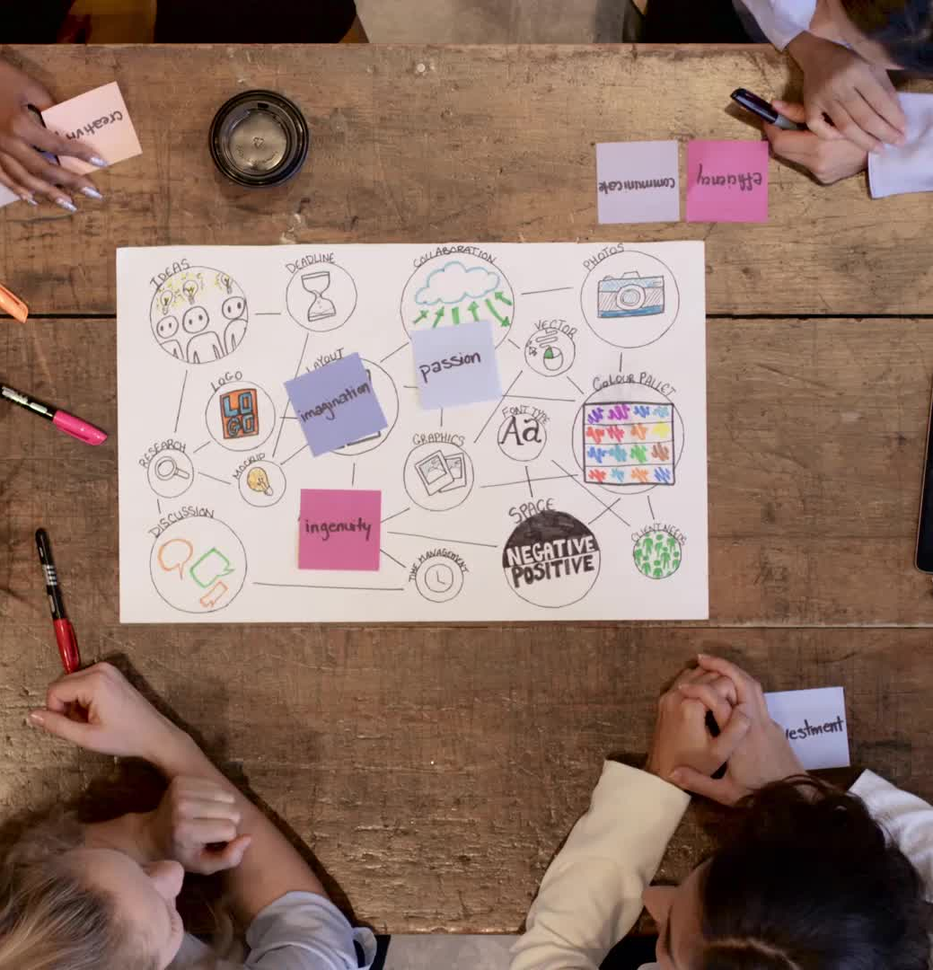
CREATIVE PITCHES
What is a Creative Pitch?
A unique pitch format that engages through creativity (e.g., product demos, videos).
Tips for Creative Pitches
Visuals: Use engaging visuals or props.
Interactivity: Involve the audience.
Storytelling: Create an emotional journey.
Example:
“At ByteCrunch, we don’t just sell snacks; we sell energy and happiness. Imagine this: You’re hiking with friends, and you pull out our protein-packed energy bar. It’s delicious, guilt-free, and keeps you going for hours. That’s the magic of ByteCrunch.”
Notes:
Scenario 15: ArtMingle: A dating app for artists. Create a pitch as a video ad for crowdfunding. Scenario 16: ByteCrunch: A healthy snack brand. Pitch to an influencer on Instagram Live. Scenario 17: SpaceAgri: A research project on farming in space. Pitch to a university board for a grant.

Slide 10
REALLY WHAT IS THE BIG DEAL????
“Pitching is not just about selling ideas; it’s about creating connections and inspiring action. Master it, and the possibilities are endless.”

